Slide 1
Big Mountain Resort - Revised Pricing
January 15, 2021

Slide 2
Problem Identification
Context:
The resort has recently installed an additional chair lift to help increase the distribution of visitors across the mountain.
This additional chair increases their operating costs by $1.54M this season.
Recommend changes that cut costs.
Criteria for Success:
Recommend changes that cut costs without undermining the ticket price or will support an even higher ticket price.
Scope of Solution Space:
Analyze the data from the 330 resorts in the US.

Slide 3
Problem Identification
Constraints within solution space:
Taking Market Average hasn’t proved to be successful in the past
Does not reliably provide importance of facilities to business
Key data sources:
CSV file from the database manager.
Contains information from 330 resorts in the US
All resorts considered part of the same market share

Slide 4
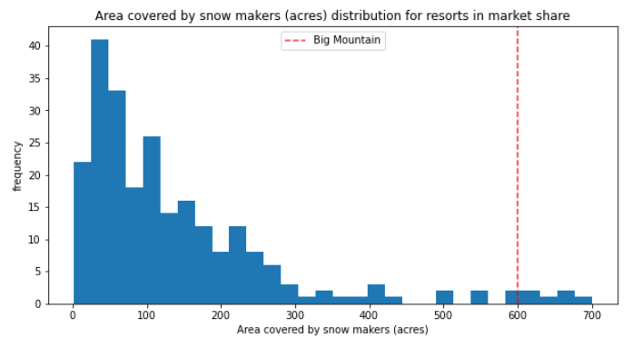
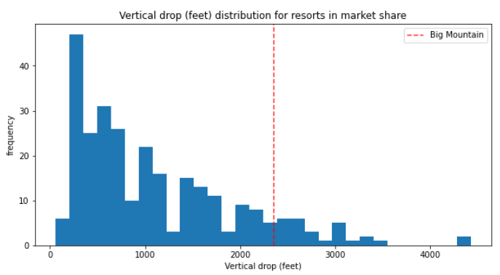
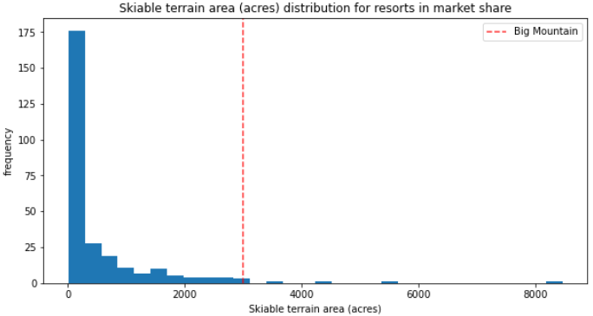
Key Findings
Big Mountain is very high up the league table of snow making area
Doing well for vertical drop
Amongst the resorts with the largest amount of skiable terrain

Slide 5
Recommendation
Increase the vertical drop by adding a run to a point 150 feet lower down:
Shows to increase support for ticket price by $1.99, which over the season could be expected to amount to $3.47M
Requires the installation of an additional chair lift to bring skiers back up without additional snow making coverage.
Assumption: On an average a visitor would buy 5 day tickets.
Note: The additional cost of the new chair lift per ticket would have to be considered.

Slide 6
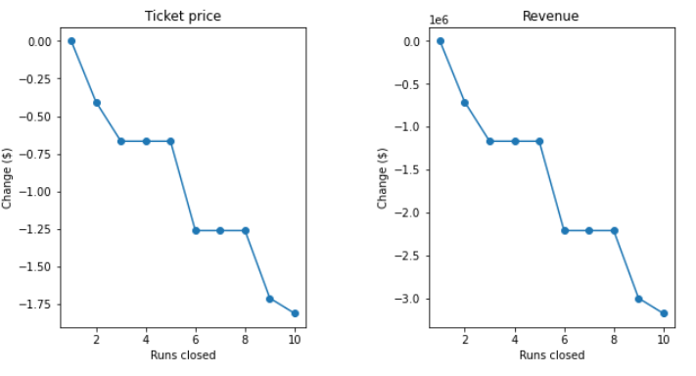
Modelled Scenarios
Permanently closing up to 10 least used runs:
Doesn't impact any other resort statistics.
Closing one run makes no difference
Closing 2 and 3 successively reduces support for ticket price and so revenue.
No further loss in ticket price if 4 or 5 runs
Increasing the closures down to 6 or more leads to a large drop.

Slide 7
Modelled Scenarios
Increase vertical drop by adding a run to a point 150 feet lower down:
Shows to increase support for ticket price by $1.99 (Season Revenue: $3.47M)
Requires the installation of an additional chair lift to bring skiers back up
Assumption: On an average a visitor would buy 5 day tickets.
Additionally adding 2 acres of snow:
Same result as #2
Such a small increase in the snow making area makes no difference
Increase the longest run by 0.2 mile to boast 3.5 miles length:
No difference whatsoever
Requires an additional snow making coverage of 4 acres

Slide 8
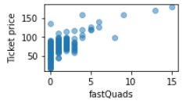
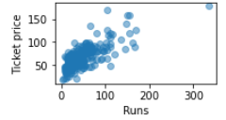
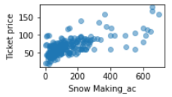
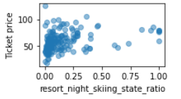
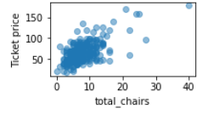
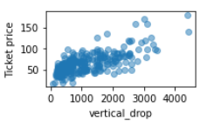
Background
Data for all the states was taken into consideration for modelling and treated equally per the exploratory data analysis.
It was found that following datapoints had high correlation to the ticket price:
Fast Quads
Runs
Snow Making area coverage
Resort to Night skiing ratio
Total chairs
Vertical drop

Slide 9
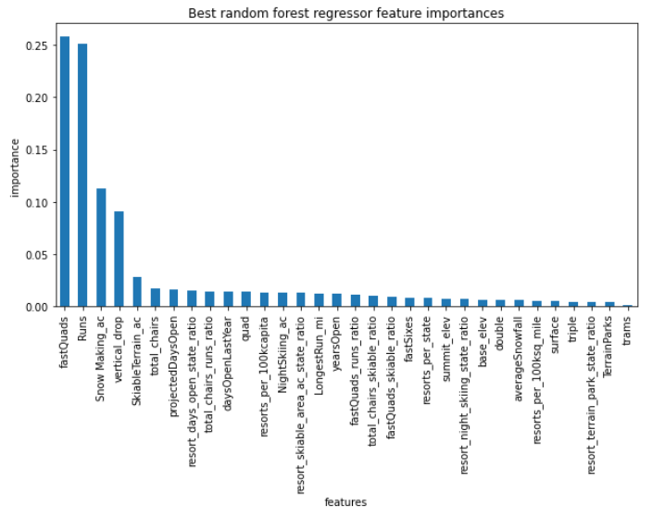
Background
Feature importance:

Slide 10
Summary
Scenario #2 i.e. to increase the vertical drop by adding a run to a point 150 feet lower down, seems most promising.
Shows to increase support for ticket price by $1.99, over the season amounting to $3.47M .
Assuming on an average a visitor would buy 5 day tickets).
However, this would also incur the additional cost of the new chair lift per ticket.

